Slide 1

CSE 4000: Project/Thesis
Automatic labeling of Twitter data for developing
COVID-19 sentiment dataset
Submitted by:
Supervised by:
K. M. Azharul Hasan
Professor, Department of CSE, KUET
Sajal Das Shovon (1607030)
Naimul Hoque Joy (1607099)
Department of Computer Science and Engineering
Khulna University of Engineering & Technology

Slide 2

Outline
Objectives
Introduction/Motivation
Related works
Proposed Method
Pre-processing
Automatic Labeling with textblob
Methodology
Label correction
Training
Logistic Regression
Long Short-Term memory (LSTM)
Multinomial Naïve Bayes
Result analysis
Conclusion
References

Slide 3
Objectives
We cover five analysis in this presentation:
1) Preprocess raw twitter data associated with COVID-19
2) Automatic Labelling the data
3) Manual Labelling dataset and Label correction using frequent label defining words
4) Sentiment analysis with Multinomial Naïve Bayes, LSTM and Logistic Regression.
5) Comparison among these effectiveness.

Slide 4
Introduction
The rapid growth of COVID-19 creates the demand for understanding the sentiment of mass people what they express in social media.
Social media contains enormous data about COVID-19 of people.
With help of NLP we are able to analyze the methods regarding sentiment analysis by using textual data extracted from twitter.

Slide 5
Introduction(Continued)
Sentiment analysis (or opinion mining) is a natural learning processing technique used to determine whether data is positive, negative or neutral.
Sentiment analysis is often performed on textual data to help businesses monitor brand or any circumstances.
We analyse our Covid-19 tweet data in terms of 4 multiclasses sentiment.

Slide 6
Related Works
Chintalapudi et al. [7] uses deep learning method to detect sentiment using labeled data.
BERT, Logistic regression (LR), Support vector machines (SVM), and long-short term
memory (LSTM) produced 89%, 75%, 74.75%, and 65%.
Manguri et al.[8] used textblob of python for sentiment analysis on twitter data
Dataset had 530232 tweets.
Radaideh et al.[10] used Naive Bayes and RNN method and labeled dataset to
positive, neutral and negative sentiment where most of the tweets came out positive.

Slide 7
Automatic labeling of Twitter data & Sentiment Analysis
Fetching dataset of using crisisNLP website
Make the dataset preprocessed.
Labeling pre-processed data using Textblob and classify in 5 multiclasses named strongly negative, negative,neutral, positive and strongly positive.
Label correction using frequent label defining words.
Remove the neutral data
Using labeled dataset to train in Logistic Regression, LSTM and Multinomial Naïve Bayes.

Slide 8
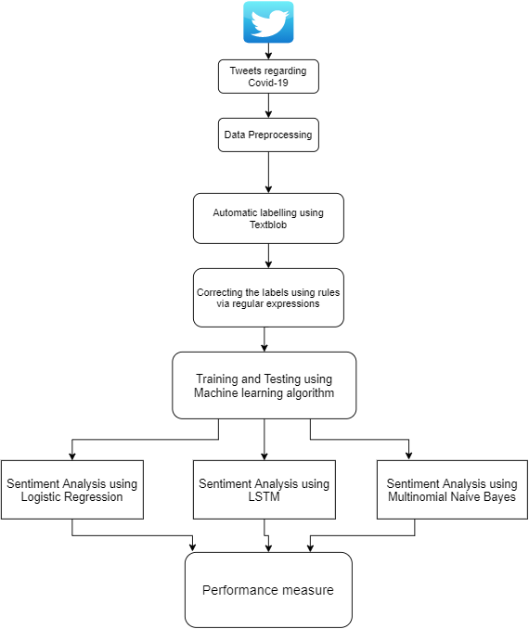
Diagram of the Methodology
Fig. 1 : Flow-chart of procedures of sentiment analysis

Slide 9
Twitter Data Acquisition & Pre-Processing
Use Twarc dehydrate method to fetch tweets.
Gathered twitter ID from CrisisNLP & using these tweet ID to hydrate tweet.
Preprocessing of dataset is a series of steps like:-
Removal of retweet
Removal of emojis & punctuation
Removal of stop words
Removal of URL tokenizing or html
Removal of Frequent and rare words
Stemming (SnowballStemmer)

Slide 10
Automatic Labelling with TextBlob
Used Textblob to label data with multiclass labelling.
The sentiment function of Textblob returns two properties, polarity and subjectivity.
Polarity is a float number ranging from [-1,1], where -1 means negative and +1 means positive
The class table like this:
Polarity Value(P) | Sentiment
-1 ≤ P ≤ -0.5 | Strongly Negative
-0.5 ≤ P ≤ 0 | Negative
0 | Neutral
0 ≤ P ≤ 0.5 | Positive
0.5 ≤ P ≤ 1 | Strongly Positive
Table 1: Textblob sentiment classification criteria

Slide 11
Manual Labelling
Textblob gives average of 65% accurate result compared to manual labeling.
With Twitter’s informal language & new terms regarding Covid-19, it is not possible to predict the right sentiment for Textblob.
Example:
“I got COVID positive yesterday.”
Textblob predicts it as positive sentiment. No way it can be positive sentiment.
Manual Labelling is needed to test and learn the system to categorize the right sentiment.

Slide 12
Manual Labelling(Continued)
For new terms of Covid and informal Twitter English statements, we used Regular Expression to make some new rules.
Used the rules to give the sentences (that are wrong in Textblob) the right sentiment.
With the revised labeled sentiment, the accuracy of authentic sentiment labeling gets higher.

Slide 13
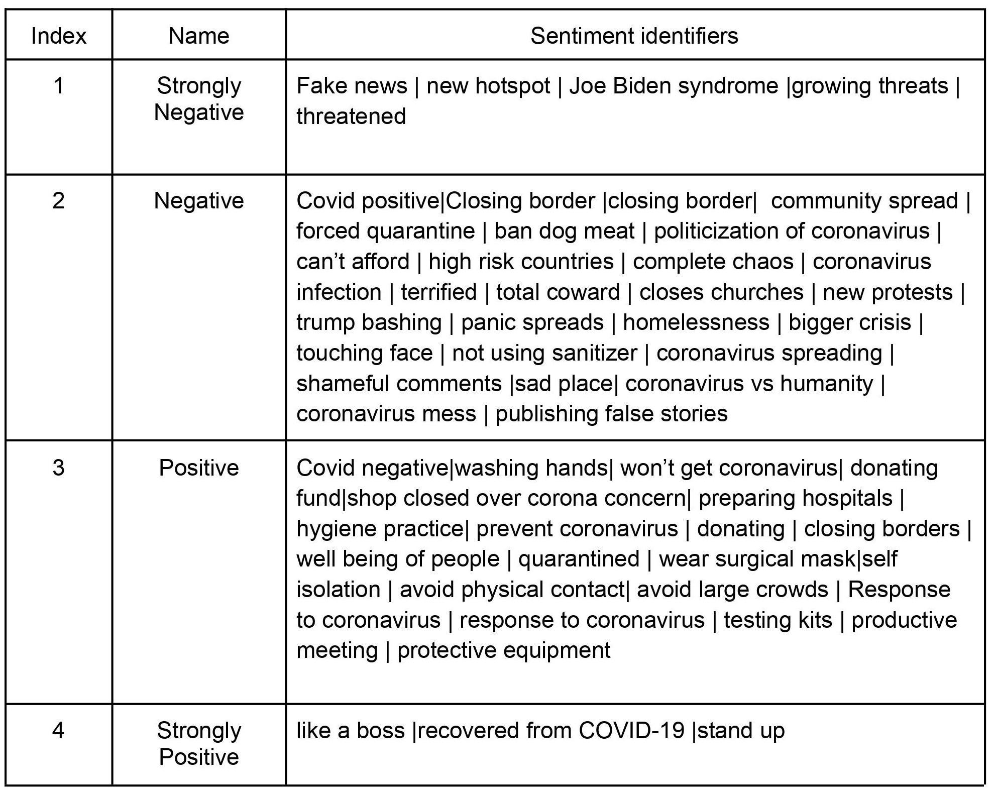
Label Correction
Some keywords for which Textblob gives wrong sentiment. We have aligned them in correct sentiment.
Table 2: Sentiment correction

Slide 14
Training the Dataset
We have acquired two datasets here. One from tweets of March and another from April 2020.
Dataset is divided into 3 sub-datasets that contains 60k, 90k & 300k data.
Used 80% of data to train our machine learning algorithm and 20% to test them.

Slide 15
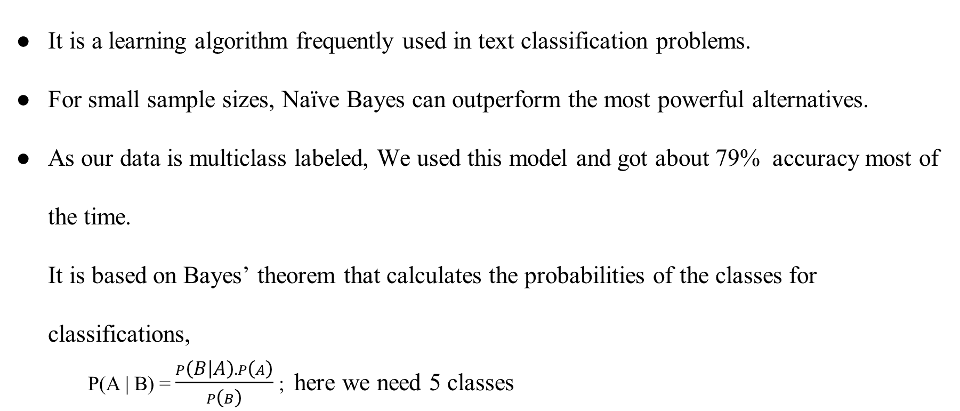
Multinomial Naïve Bayes
It is a learning algorithm frequently used in text classification problems.
For small sample sizes, Naïve Bayes can outperform the most powerful alternatives.
As our data is multiclass labeled, We used this model and got about 79% accuracy most of the time.
It is based on Bayes’ theorem that calculates the probabilities of the classes for classifications,
P(A | B) = $\frac{P\left(B | A\right).P\left(A\right)}{P\left(B\right)}$ ; here we need 5 classes

Slide 16
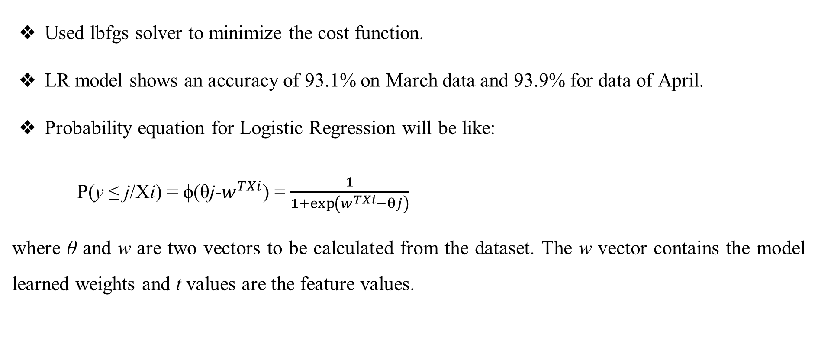
Logistic Regression
Used lbfgs solver to minimize the cost function.
LR model shows an accuracy of 93.1% on March data and 93.9% for data of April.
Probability equation for Logistic Regression will be like:
P(y ≤ j/Xi) = ϕ(θj-$w^{TXi}$) = $\frac{1}{1+\exp\left(w^{TXi}−θj\right)}$
where θ and w are two vectors to be calculated from the dataset. The w vector contains the model learned weights and t values are the feature values.

Slide 17
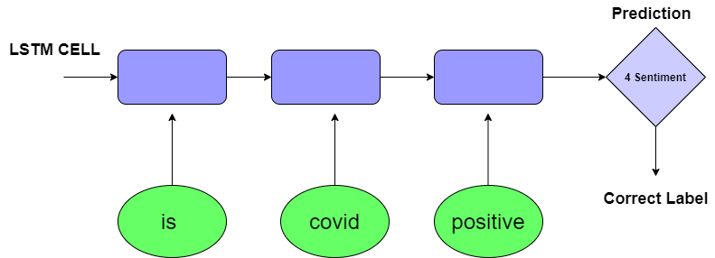
Long Short-Term Memory(LSTM)
LSTM is a deep learning architecture that works with sequential data to solve classification problem
Used the LSTM with 128 hidden units with activation function ’softmax’ to classify the 4 classes.
The model is trained for 10 epochs with batch size 32.
Dropout rate to 0.3 with the learning rate of 0.05.
Fig. 2: Text processing realization by LSTM

Slide 18
Discussion of our process with example:
Example:1
Raw tweet :
RT @ConradGoode: The missing six weeks: how Trump failed the biggest test of his life https://t.co/SAIHSF1fdF
Pre processed data:
miss six week trump fail biggest test life
Label : Strongly negative

Slide 19
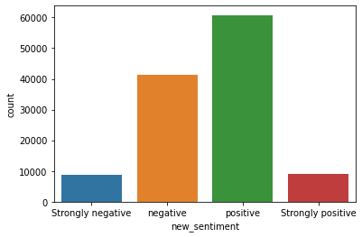
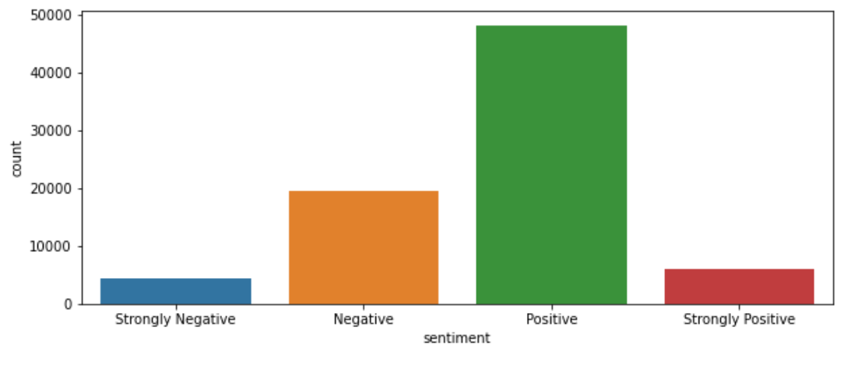
Performance analysis
Fig. 3: Distribution of sentiments for Covid-19 twitter data
Fig. 4: Sentiment distribution of reference data

Slide 20
Result Analysis and Visualization:
Neutral sentiment percentage is much more than other sentiments.
The all three datasets show the same.
Neutral sentiment is getting more & more percentage with the growing of data, and the negative sentiment is getting lower with more data.
For positive sentiment we notice the same just like negative sentiment.

Slide 21
Result Analysis
Method | Precision | Recall | F1 score
MNB | 0.87 | 0.62 | 0.68
LR | 0.91 | 0.89 | 0.90
LSTM | 0.96 | 0.96 | 0.96
Method | Precision | Recall | F1 Score
MNB | 0.83 | 0.44 | 0.44
LR | 0.88 | 0.83 | 0.85
LSTM | 0.94 | 0.94 | 0.94
Table 3 : Performance measure for Dataset1 (March)
Table 4 : Performance measure for Dataset2 (April)

Slide 22
Comparison with existing methods
The following topic is now very much trending these days. These are some existing methods which are working way:
Existing Methods | Dataset Size | Sentiment Class | Used Models | Accuracy
Manguri et al.[8] | 500,000 tweets | 3 classes (optimistic, neutral and negative) | Naïve Bayes | -
Naseem et al. [9] | 90,000 tweets | 3 classes (positive, neutral and negative) | SVM, RF, NB, DT | SVM(83.9%), RF(83.6%), NB(76.5%), DT(78.1%)(On a subset of main dataset containing 30,000 tweets)
Radaideh et al.[10] | 833 tweets | 3 classes (positive, neutral and negative) | Naïve Bayes & RNN | Naïve Bayes(83%) & RNN(79%)
Table 5: How existing methods are working

Slide 23
Comparison with existing methods (Continued)
How our methodology works:-
Dataset: Primarily dataset is of 300,000, after automatic labeling & discarding the neutral data, the final dataset is 110,000.
Sentiment Class: At first we classify the dataset in 5 multiclass. After discarding the neutral sentiment we have 4 classes finally.
Used Models: Three models called Multinomial Naïve Bayes, Logistic Regression & LSTM
Accuracy: Multinomial Naïve Bayes, Logistic Regression & LSTM have the accuracy of 79%, 92%, 96% respectively.

Slide 24
Conclusion
i) We used the sentiment correction table to automatically correct the Textblob label.
ii) Long Short-Term memory (LSTM) has more accuracy than Logistic Regression and
Multinomial Naive Bayes.
iii) Neutral sentiments are larger compared to positive and negative sentiment combined
iv) The bigger the dataset the more the neutral sentiment whether both positive
& negative sentiment getting lower .

Slide 25
Future Work
Our future works are as below:-
Enlarge the dataset and investigate further sentiment analysis and undergo an analogy month by month dataset.
Compare sentiment with pre-covid era and post covid time to visualize more about sentiment.
Increase accuracy with others methods too.

Slide 26
Publication
Our thesis work was published in the 5th International Conference on Electrical Information and Communication Technology (EICT 2021) and awarded as Best paper.
The source is given below:
K. M. Azharul Hasan, S. D. Shovon, N. H. Joy and M. S. Islam, "Automatic Labeling of Twitter Data for Developing COVID-19 Sentiment Dataset," 2021 5th International Conference on Electrical Information and Communication Technology (EICT), 2021, pp. 1-6, doi: 10.1109/EICT54103.2021.9733548.

Slide 27
References
Some references we took in our knowledge to do the analysis better:-
[1] R. Singh, R. Singh, and A. Bhatia, “Sentiment analysis using machine learning technique to predict outbreaks and epidemics,” Int. J. Adv. Sci. Res, vol. 3, no. 2, pp. 19–24, 2018
[2] S. Chawla, M. Mittal, M. Chawla, and L. Goyal, “Corona virus-sars-cov-2: an insight to another way of natural disaster,” EAI Endorsed Transactions on Pervasive Health and Technology, vol. 6, no. 22, p. e2, 2020
[3] K. Chakraborty, S. Bhattacharyya, and R. Bag, “A survey of sentiment analysis from social media data,” IEEE Transactions on Computational Social Systems, vol. 7, no. 2, pp. 450–464, 2020.
[4] R. Chandra and A. Krishna, “Covid-19 sentiment analysis via deep learning during the rise of novel cases,” arXiv preprint arXiv:2104.10662, 2021

Slide 28
Thank You!!

